Slide 1

Big Data 1 TEAM Project
Group-5

Slide 2

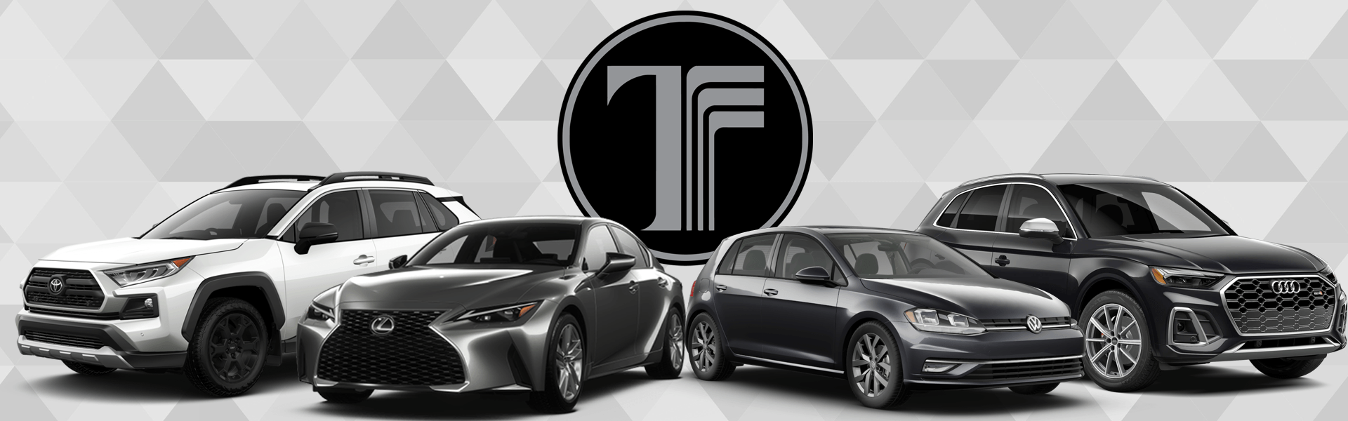
Automobile Dealership Analysis

Slide 3
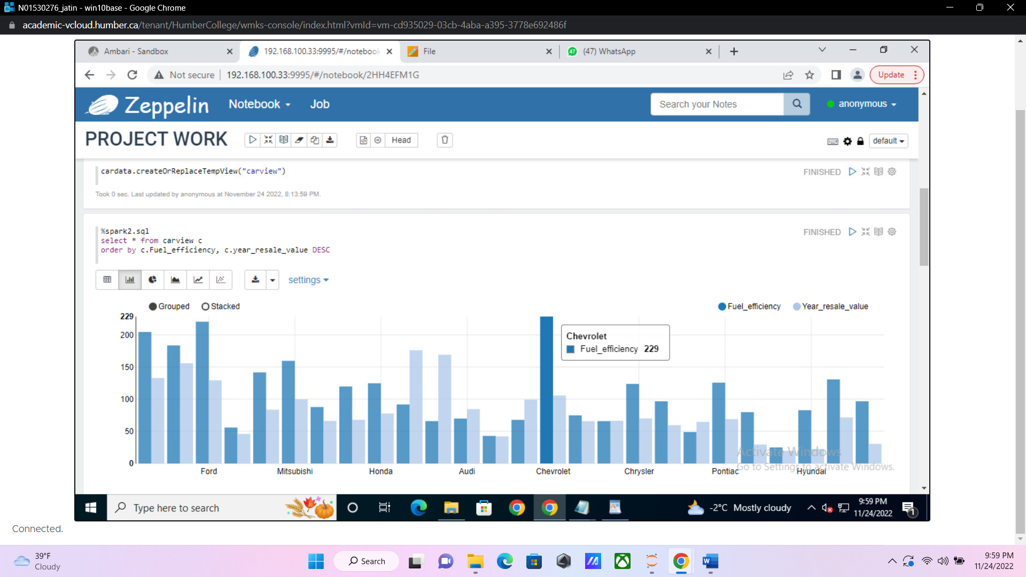
CARS WITH FUEL EFFICIENCY ABOVE 20 AND RESALE VALUE ABOVE $43000

Slide 4
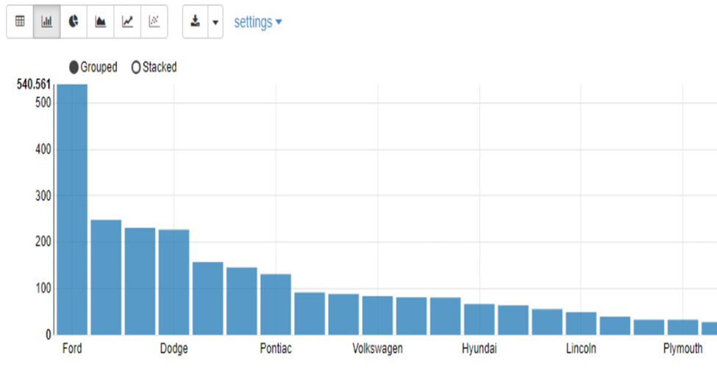
Car manufacturers which have the maximum sale value for one unit

Slide 5
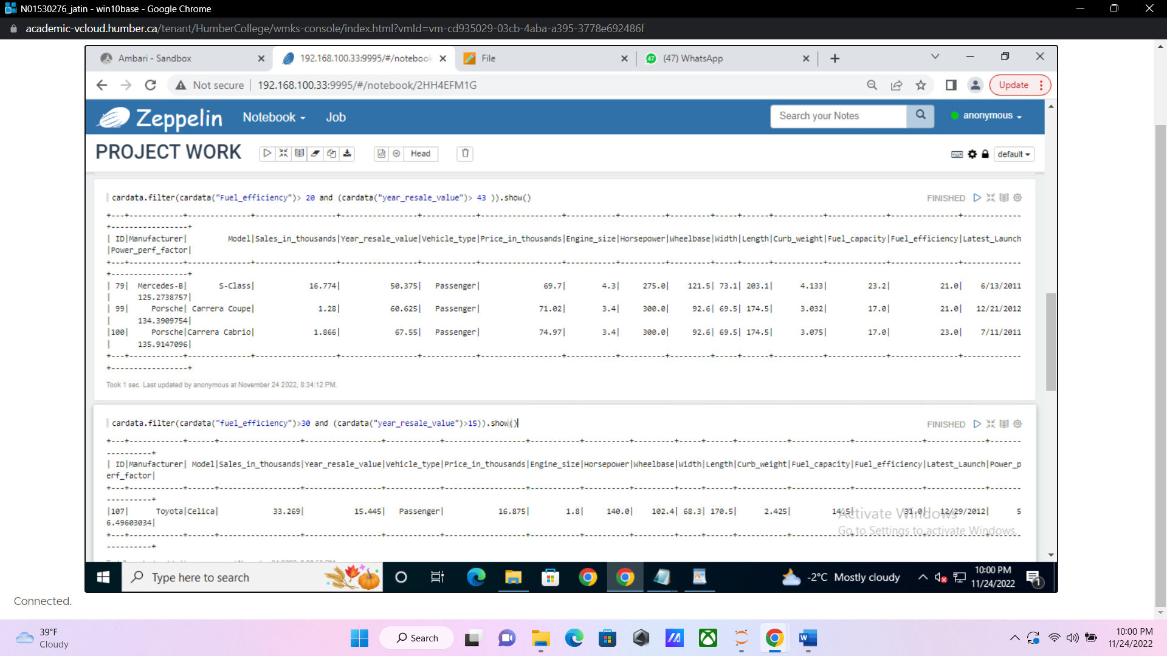
CARS WITH FUEL EFFICIENCY ABOVE 30 AND RESALE VALUE ABOVE $15000

Slide 6
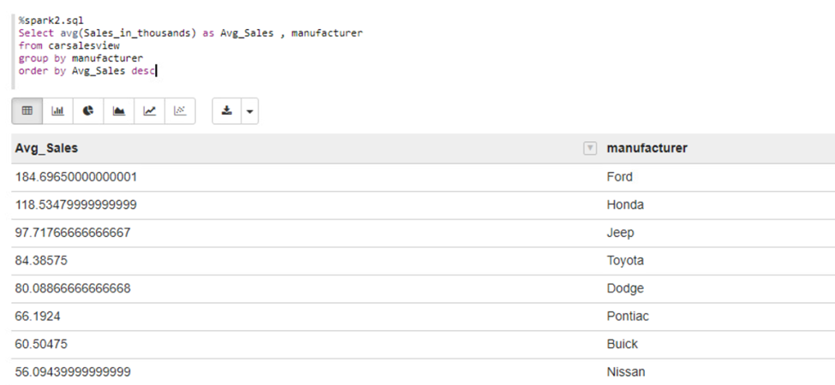
Analyzing the average sales for each CAR manufacturer

Slide 7
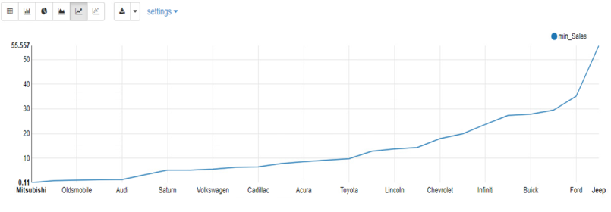
Car manufacturers which have the minimum sale value for one unit

Slide 8
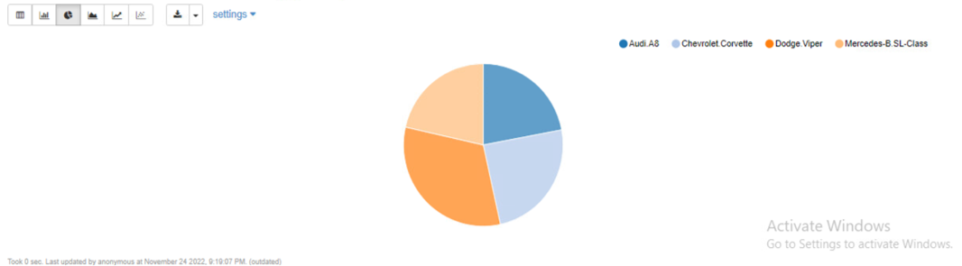
Top cars on the basis of horsepower

Slide 9
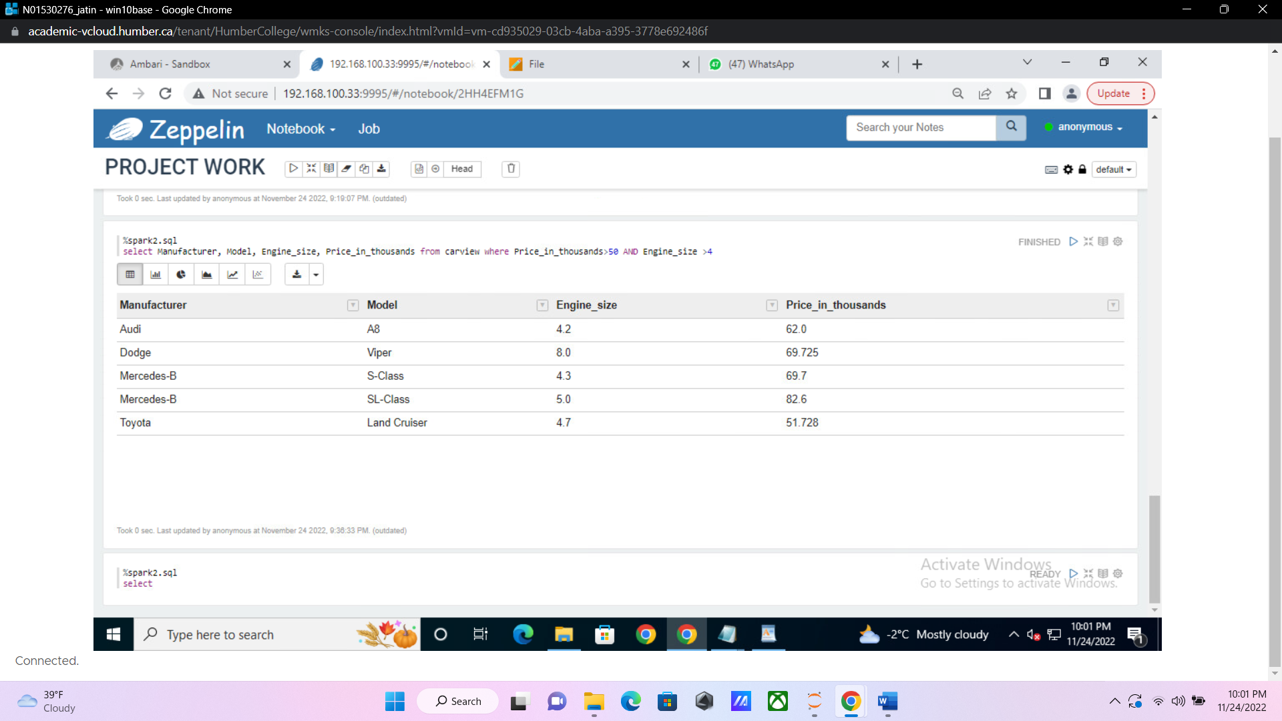
Analyzing car manufacturers and models on the basis of their engine size and price

Slide 10
RECOMMENDATIONS

Slide 11
References
DATASET HAS BEEN TAKEN FROM KAGGLE
https://www.kaggle.com/datasets/gagandeep16/car-sales?resource=download

Slide 12
Thank you
GROUP 5 –
JATIN MEHRA
CHANDEEP SINGH
DAMANDEEP SINGH
ISHAN SAHNI
NAKUL SHARMA
MANOJ MADDUKURI
MANMEET SINGH

